Slide 1


Slide 2
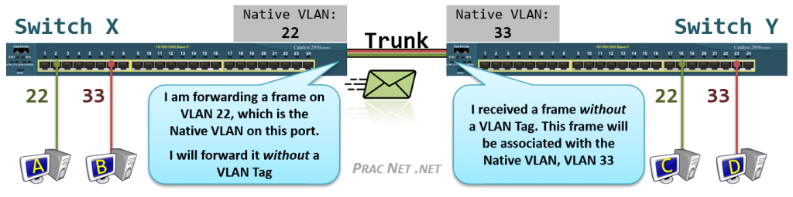
Native VLAN
The Native VLAN is the answer to how a switch processes traffic it receives on a Trunk port which does not contain a VLAN Tag. Without the tag, the switch will not know what VLAN the traffic belongs to, therefore the switch associates the untagged traffic with what is configured as the Native VLAN. Essentially, the Native VLAN is the VLAN that any received untagged traffic gets assigned to on a Trunk port.
Additionally, any traffic the switch forwards out a Trunk port that is associated with the Native VLAN is forwarded without a VLAN Tag.
The Native VLAN can be configured on any Trunk port. If the Native VLAN is not explicitly designated on a Trunk port, the default configuration of VLAN #1 is used.
That being said, it is crucially important that both sides of a Trunk port are configured with the same Native VLAN. This illustration explains why:
Above we have four Hosts (A, B, C, D) all connected to Access Ports in VLAN #22 or VLAN #33, and Switch X and Switch Y connected to each other with a Trunk port.
Host A is attempting to send a frame to Host C. When it arrives on the switch, Switch X associates the traffic with VLAN #22. When the frame is forwarded out Switch X’s Trunk port, no tag is added since the Native VLAN for the Trunk Port on Switch X is also VLAN #22.
But when the frame arrives on Switch Y without a tag, Switch Y has no way of knowing the traffic should belong to VLAN #22. All it can do is associate the untagged traffic with what Switch Y’s Trunk port has configured as the Native VLAN, which in this case is VLAN #33.
Since Switch Y will never allow VLAN #33 traffic to exit a VLAN #22 port, Host C will never get this traffic. Even worse, due to a Switch’s flooding behavior, Host D might inadvertently get the traffic that was destined to Host C.

Slide 3
Native VLAN continuation:
To set the Native VLAN, you use this command:
Switch3(config)# interface e0/1 SwitchX(config-if)# switchport trunk native vlan 20
After setting this command, any time Switch3 is sending traffic on VLAN 20 out the trunk port e0/1, it will send frame without adding a VLAN tag. Moreover, anytime Switch3 receives untagged traffic on trunk port Eth0/1, Switch3 will assign that traffic to VLAN 20.
An important point to remember: both switches on either end of the same trunk must have the same Native VLAN. Otherwise, you easily run the risk of a host in one VLAN being able to communicate with a host in another VLAN.
Therefore, we will set the same Native VLAN on Switch5:
Switch5(config)# interface Ethernet 0/1 SwitchY(config-if)# switchport trunk native vlan 20
show vlan brief
show interfaces trunk
show interfaces switchport
show interfaces status
show spanning-tree

Slide 4
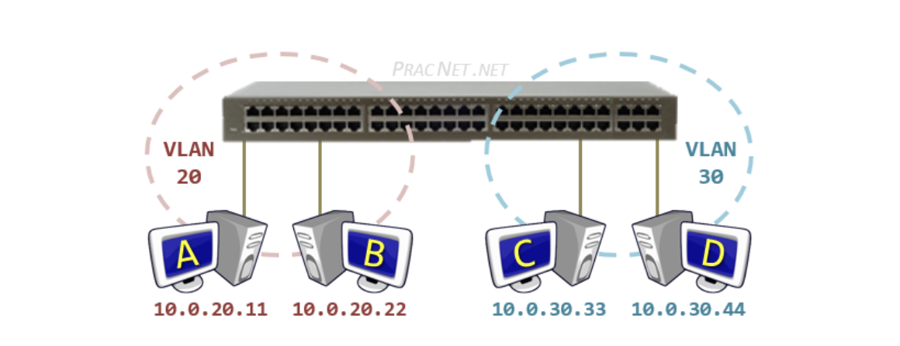
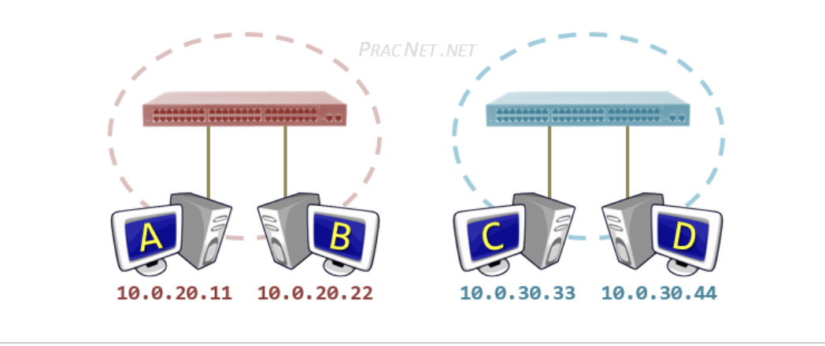
Inter VLAN routing:
Why do we need Routing Between VLANs?
As we learned before, VLANs create a logical separation between Switch ports. Essentially, each VLAN behaves like a separate physical switch. To illustrate this, below are two topology pictures of the same environment – one Physical and one Logical.
The Physical topology depicts a switch and four hosts in two different VLANs – Host A and Host B are in VLAN 20 and Host C and Host D are in VLAN 30. The logical topology reflects how the physical topology operates – the two VLANs essentially create two separate physical switches.
Physical
logical

Slide 5
Inter VLAN routing:
Why do we need Routing Between VLANs?
As we learned before, VLANs create a logical separation between Switch ports. Essentially, each VLAN behaves like a separate physical switch. To illustrate this, below are two topology pictures of the same environment – one Physical and one Logical.
The Physical topology depicts a switch and four hosts in two different VLANs – Host A and Host B are in VLAN 20 and Host C and Host D are in VLAN 30. The logical topology reflects how the physical topology operates – the two VLANs essentially create two separate physical switches.
Physical
logical

Slide 6
Despite all four hosts being connected to the same physical switch, the logical topology makes it clear that the hosts in VLAN 20 are unable to speak with the hosts in VLAN 30. Notice since there is nothing connecting the two “virtual” switches, there is no way for Host A to speak to Host C.
Since Host A and Host C are in different VLANs, it is also implied that they are in different Networks. Each VLAN will typically correspond to its own IP Network. In this diagram, VLAN 20 contains the 10.0.20.0/24 network, and VLAN 30 contains the 10.0.30.0/24 network.
The purpose of a Switch is to facilitate communication within networks. This works great for Host A trying to speak to Host B. However, if Host A is trying to speak to Host C, we will need to use another device – one whose purpose is to facilitate communication between networks.
If you’ve read the Packet Traveling series, then you know that the device which facilitates communication between networks is a Router.
A router will perform the routing function necessary for two hosts on different networks to speak to one another. In the same way, a Router is what we will need in order for hosts in different VLANs to communicate with one another.
There are three options available in order to enable routing between the VLANs:
Router with a Separate Physical Interface in each VLAN
Router with a Sub-Interface in each VLAN
Utilizing a Layer 3 Switch

Slide 7
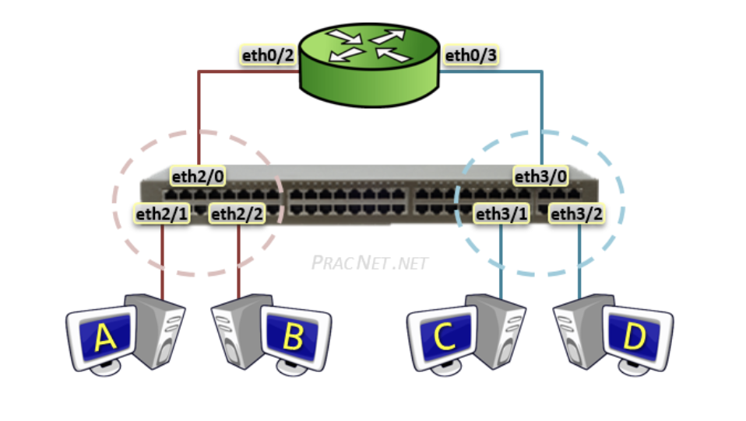
Router with Separate Physical Interfaces
he Router doesn’t know that it has two connections to the same switch — nor does it need to. The Router operates like normal when routing packets between two networks.
In fact, the process of a packet moving from Host A to Host D in this topology will work exactly as it does in this video. The only difference is since there is only one physical switch, there will only be one MAC address table – each entry includes the mapping of switchport to MAC address, as well as the VLAN ID number that port belongs to.
Each switch port in this diagram is configured as an Access port, we can use the range command to configure multiple ports as once:
Switch(config)# interface range eth2/0 - 2 Switch(config-if-range)# switchport mode access Switch(config-if-range)# switchport access vlan 20 Switch(config)# interface range eth3/0 - 2 Switch(config-if-range)# switchport mode access Switch(config-if-range)# switchport access vlan 30
Router(config)# interface eth0/2
Router(config-if)# ip address 10.0.20.1 255.255.255.0
Router(config-if)# no shutdown
Router(config)# interface eth0/3
Router(config-if)# ip address 10.0.30.1 255.255.255.0
Router(config-if)# no shutdown
Show run
Show ip int brief
Show ip route
Show arp
Show cdp neighbor

Slide 8
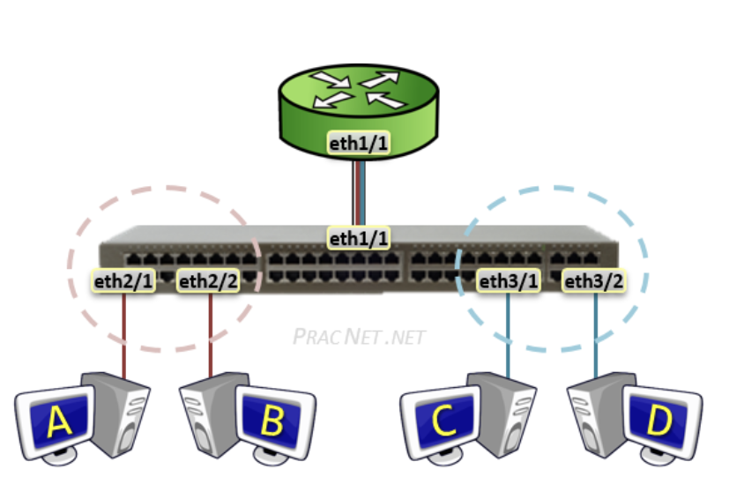
Router with Sub-Interfaces
A Sub-Interface allows a single Physical interface to be split up into multiple virtual sub-interfaces, each of which terminate their own VLAN.
Sub-interfaces to a Router are similar to what Trunk ports are to a Switch – one link carrying traffic for multiple VLANs. Hence, each router Sub-interface must also add a VLAN tag to all traffic leaving said interface.
The logical operation of the Sub-interface topology works exactly as the separate physical interface topology in the section before it. The only difference is with Sub-interfaces, only one Router interface is required to terminate all VLANs.
Keep in mind, however, that the drawback with all VLANs terminating on a single Router interface is an increased risk of congestion on the link.
The Sub-interface feature is sometimes referred to as Router on a Stick or One-armed Router. This is in reference to the single router terminating the traffic from each VLAN.
The Switch’s port facing the router is configured as a standard Trunk:
Switch(config)# interface eth1/1 Switch(config-if)# switchport trunk encapsulation dot1q Switch(config-if)# switchport mode trunk
Router(config)# interface eth1/1 Router(config-if)# no shutdown
Router(config)# interface eth1/1.20 Router(config-subif)# encapsulation dot1Q 20 Router(config-subif)# ip address 10.0.20.1 255.255.255.0
Apart from using the Sub-interface distinguisher (eth1/1.20) and using the encapsulation dot1q <VLAN#> command, the rest of the interface configuration is exactly the same as any other regular physical interface. Similarly, we will also configure the Sub-interface for VLAN 30:
Router(config)# interface eth1/1.30 Router(config-subif)# encapsulation dot1Q 30 Router(config-subif)# ip address 10.0.30.1 255.255.255.0

Slide 9
Layer 3 Switch
A Layer 3 Switch is different from a traditional Layer 2 Switch in that it has the functionality for routing between VLANs intrinsically. In fact, when considering how a L3 Switch operates, you can safely imagine that a Layer 3 Switch is a traditional switch with a built in Router.
With regard to VLANs the Multilayer switch is configured mostly the same way as a regular L2 switch:
MultilayerSwitch(config)# vlan 20 MultilayerSwitch(config-vlan)# name RED MultilayerSwitch(config)# vlan 30 MultilayerSwitch(config-vlan)# name BLUE MultilayerSwitch(config)# interface range eth2/0 - 2 MultilayerSwitch(config-if-range)# switchport mode access MultilayerSwitch(config-if-range)# switchport access vlan 20 MultilayerSwitch(config)# interface range eth3/0 - 2 MultilayerSwitch(config-if-range)# switchport mode access MultilayerSwitch(config-if-range)# switchport access vlan 30
An SVI serves as the L3 termination point for each VLAN – aka, the way in or out of each VLAN. Another way of looking at it is that the SVI serves as the interface on the built-in Router of the Multilayer switch, allowing traffic from one VLAN to reach the built-in Router and be routed to another VLAN as necessary.
The configuration for an SVI involves two parts. First, enabling IP Routing; and Second, applying an IP address to the VLAN.
To enable IP Routing, use the following command:
MultilayerSwitch(config)# ip routing
IP Routing only needs to be enabled once. Some L3 switches come with it enabled by default. Applying the command while it is already enabled will not cause any harm, so if in doubt as to whether it is already enabled or not, simply applying it again is safe.
To apply an IP address to the VLANs, configure the SVI as follows:
MultilayerSwitch(config)# interface vlan 20 MultilayerSwitch(config-if)# ip address 10.0.20.1 255.255.255.0 MultilayerSwitch(config-if)# no shutdown MultilayerSwitch(config)# interface vlan 30 MultilayerSwitch(config-if)# ip address 10.0.30.1 255.255.255.0 MultilayerSwitch(config-if)# no shutdown
When Host A sends a packet to Host B, the packet will be switched within the same VLAN – no L3 processing will occur.
When Host A sends a packet to Host C, the packet will be sent to the SVI to be routed to the other VLAN – all regular L3 processing will occur: the TTL will be decremented and the L2 header will be rewritten.

